Slide 1

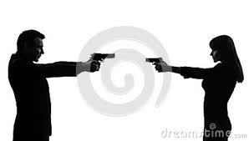
Active Intruder

Slide 2





Instructions
For the video to play click the icon for Active Shooter multi-media video.
Click the button upper right corner of the video player to close when finished viewing.
Complete your quiz with a minimum 80%.

Slide 3
Active Intruder
It can happen to you or at our Hospital!
Be Prepared!
Be Ready!
Be Knowledgeable!

Slide 4

Video
Click
Some terms, and phrases contained in or used on this website and presentation are subject to copyright or trademark restrictions. Reproduction or use of these items is limited by the following terms and conditions. See references page for more information.

Slide 5
Basic Principals
CALL OUT!
  Report - Notify police or security
GET OUT!
  RUN - You and others safely exit/escape
HIDE OUT!
  HIDE – You and others locate a good place to hide and fortify
TAKE OUT!
  FIGHT – You and or others take out the intruder/shooter

Slide 6
Be Prepared!
Be prepared for any situation at any time!
Look around you!
Look for a way out other than the way you came in!
Pay attention to the floor plan, the direction doors swing, potential hiding spots!
Don’t be fooled into thinking it cannot happen to you or our hospital!

Slide 7
Be Ready
Know where you are:
  Familiarize yourself with the area, know where to hide or exit.
Know what the person looks like:
  Identify the Height, Race, Gender, Language, or Language Accent if possible.
Know what the threat is:
  Identify what kind of weapon; Gun, Knife, Bomb, etc.
Know what area the intruder came from or went to
  What entrance they came in, location on property, and/or the direction they went.
Know the correct number to call for help
  Never assume someone else has called for help!
Know who is with you
  Adults, Elderly, Children, and/or Security

Slide 8
Be Knowledgeable
If you are going to go to Take Out/ Fight Mode, then make sure you have a plan. Be prepared to improvise a weapon and be committed in order to succeed.
Don’t be a victim, take control of the situation.

Slide 9



Choose to Make a Difference!
“If we’re going to change things … it’s going to take a wave of Americans … standing up and saying ‘enough’ on behalf of our kids.”
"Heroes may not be braver than anyone else. They're just braver five minutes longer."
Ronald Reagan

Slide 10
Stages
5 stages of an active shooter
  Fantasy
  Planning
  Preparation
  Approach
  Implementation

Slide 11
General Shooting Statistics
9% Church or Military Base
17% Outside
36% Schools
38% Businesses

Slide 12
Hospital Statistics
2000- 2011 Hospital Shootings
  59% in the Hospital
  29% in the ED
  19% in Patient Rooms
  11% Other Areas
20% Were Hospital Employee Targets
  3% were Physicians
  5% were Nurses
Motives were
  Grudge
  Suicide
  Euthanization
  Prisoner escape

Slide 13
How to Prepare
Develop awareness of surroundings so you can quickly assess and react to a situation.
Roll play; Build mental markers!
Rehearse and practice plans.
We need to prepare ourselves, if “X” happens what am I going to do?

Slide 14
KISS
K Keep calm:
  Disasters happen quickly, have simple plans that are easy to follow
I Involve everyone;
  In the planning;
S Stressful:
  Practice simulation and training
S Situations:
Practice the basics

Slide 15
Stop the Killing
Consider personal safety first.
Evacuate to safer environment.
Call for help 911
Administer first aide to injured if safe.
Triage high risk to low risk patients.

Slide 16

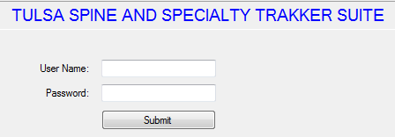
TSSH Policy
Locate
TSSH Trakker Login Desktop
Login and locate Active Intruder Policy.

Slide 17
TSSH Personal Safety
Get Out/ RUN
  Leave the area if possible
Hide Out / HIDE
  Locate a room to hide, lock or barricade the door.
  Remain quiet!
  While waiting be making a take out plan and gather possible defensive weapons.
Take Out/ FIGHT
  Have a plan!
  Be committed to that take out plan.

Slide 18
Police Priority
The priority is to apprehend the threat to make the area safe for the hostage and innocent bystanders.
The police will not help the injured until the threat is eliminated.

Slide 19
Police Expectations
Do’s
  Be quiet and compliant
  Realize that they don’t know who is a threat
  Keep hands visible and open with fingers spread
  Tell the officer where you last saw the intruder
Don’t
  Grab the police officer
  Hide your hands
  Scream or yell

Slide 20
TSSH Facility Safety
Initiate hospital incident command center.
Make sure all entrances are manned allowing police access and information.
Police will set up:
  Police command center
  Media liaison
  Designation offsite media briefing center
  Designation of triage area
  Evacuate the building
  Designation of helicopter landing area
  Designation of ambulance staging area
  Designation of reunification area (family and patients)

Slide 21



Local, State, and Federal
Resources
Click on the three Images above for more information.

Slide 22
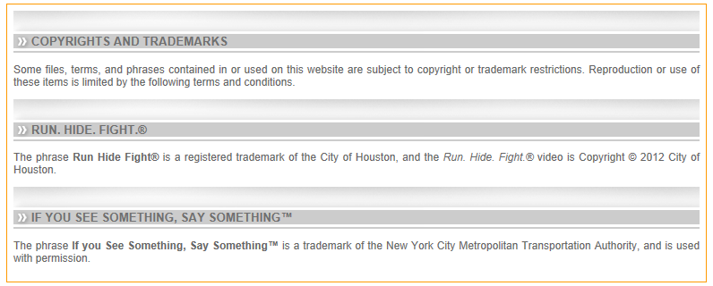
References
The information from http://www.readyhoustontx.gov/videos.html is funded by the US Department of Homeland Security under the Urban Area Security Initiative grant program. It is a project of the Houston UASI Community Preparedness Committee, and is produced by the City of Houston Office of Public Safety and Homeland Security.

